Slide 1

COOCHBEHAR GOVERNMENT ENGINEERING COLLEGE
PROJECT TOPIC: ARDUINO BASED MINI CNC 2D PLOTTER
MENTOR: DR. PALASH DAS
BY
PRIYANSHI MAKUR (34900323037)
PROLAY KAYAL (34900323039)
RAJORSI SINHARAY (34900323041)
RIJIYA SULTANA (34900323042)
RUPAYAN SARKAR (34900323043)
SNEHA ADHIKARY (34900323049)

Slide 2
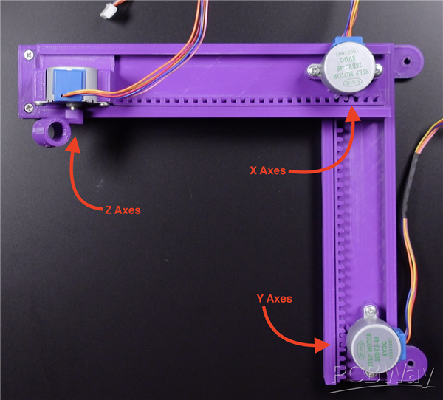
Introduction to Arduino-Based Mini CNC Plotters
An Arduino-Based Mini CNC Plotter is a compact, low-cost machine that automatically draws text, images, and designs on paper. It uses an Arduino Uno, stepper motors(28BYJ-48 stepper motor), and stepper motor driver(ULN2003 or A4988) to control the movement of the pen along the X, Y, and Z axes. The plotter operates using G-code generated from digital designs, making it an excellent project for learning CNC technology, automation, and embedded systems.
Notes:
Image source: https://www.slidemake.com

Slide 3
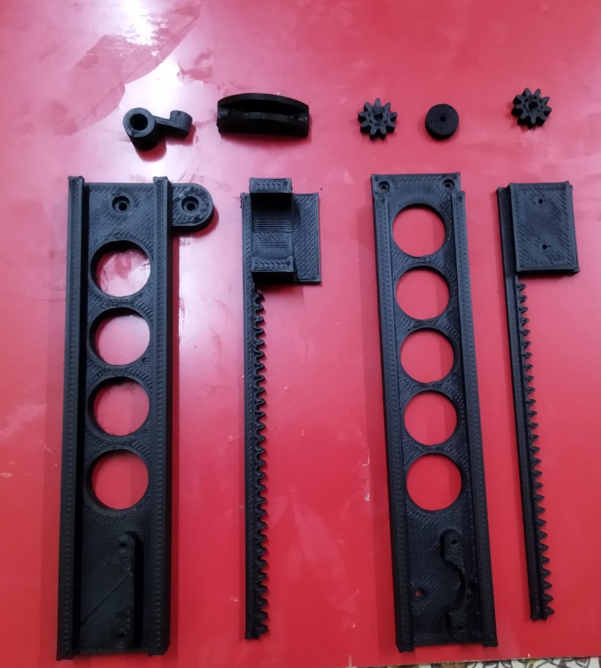
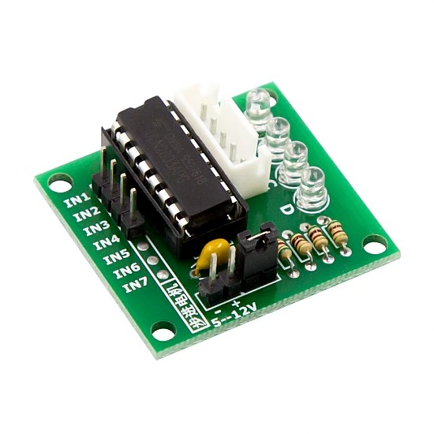
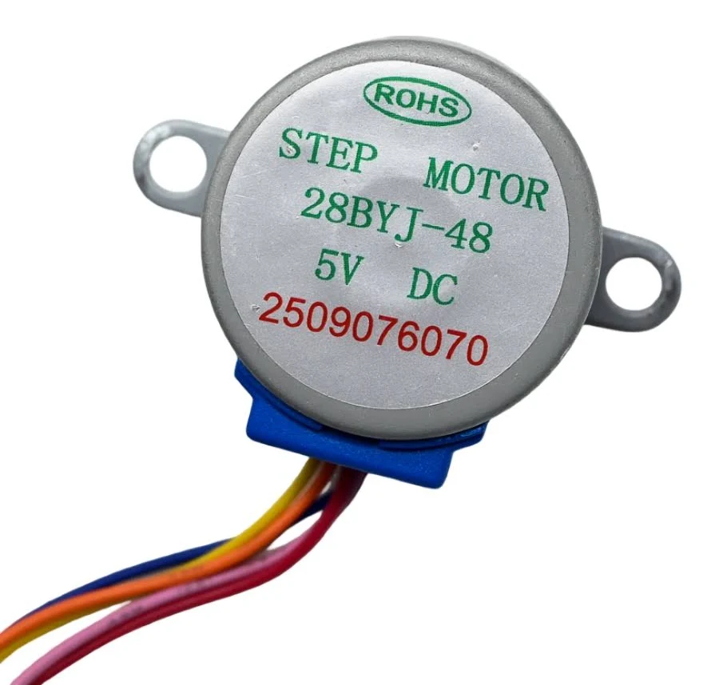
Components and Hardware Requirements of a Mini CNC PLOTTER
​To construct this mini CNC plotter, the following hardware components are required:
​Microcontroller: Arduino Uno (or Nano).
​Actuators: 3x Hobby Stepper Motors (e.g., 28BYJ-48 or similar)
​Motor Drivers: 3x Stepper Motor Driver Modules compatible with the motors (e.g., ULN2003 depending on motor specs)
​Structure: 3D Printed Parts for the mechanical frame, axis rails, and pen holder mechanism
​Power Supply: External 5V to 9V DC Power Supply to power the motor drivers
Jumper wires
Sunboard (for base)
Screws
ULN2003 STEPPER MOTOR DRIVER
28BYJ-48 STEPPER MOTOR
Notes:
Image source: https://i.ytimg.com

Slide 4
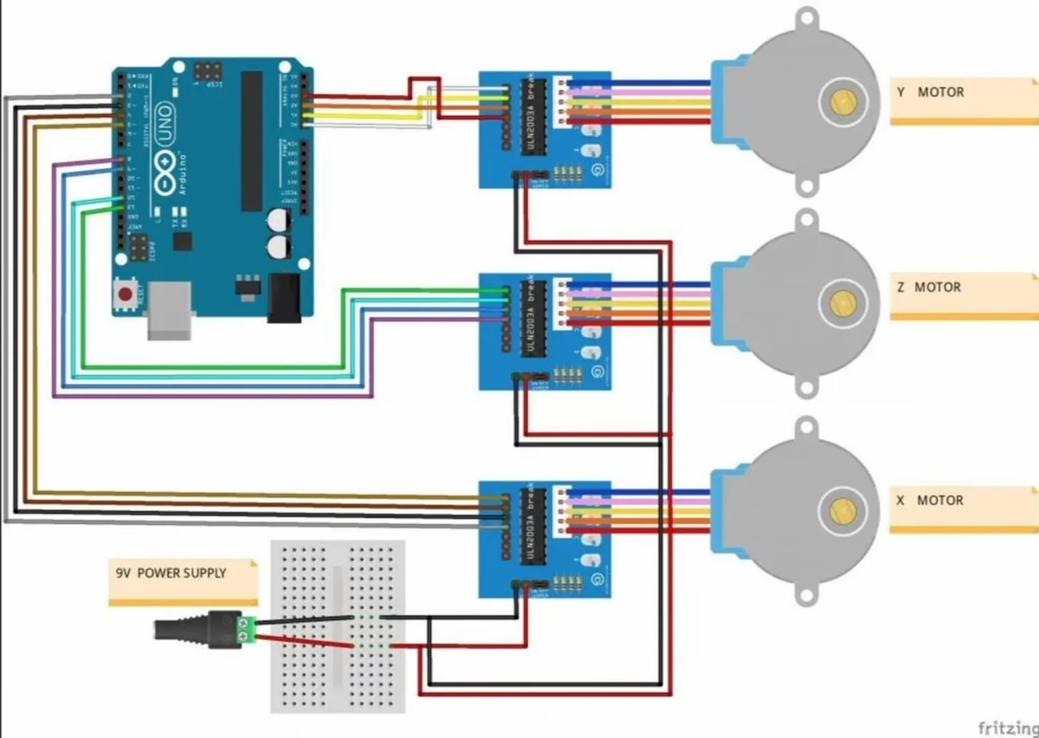
Design and Construction
The frame is built using plywood, providing a rigid and stable structure for smooth operation.
The plotter uses two stepper motors to control movement along the X-axis and Y-axis, while a 28BYJ-48 stepper motor lifts and lowers the pen during plotting.
An Arduino Uno acts as the main controller and sends control signals to the ULN2003 stepper motor drivers, which drive the motors with high precision.
Mechanical components such as linear rods, timing belts, pulleys, and sliders ensure accurate and smooth movement in both directions.
All electronic components are connected according to the circuit diagram, powered by a 5V to 9V DC supply, and calibrated to achieve precise and reliable drawing performance.
CIRCUIT DIAGRAM
Notes:
Image source: https://i.pinimg.com

Slide 5
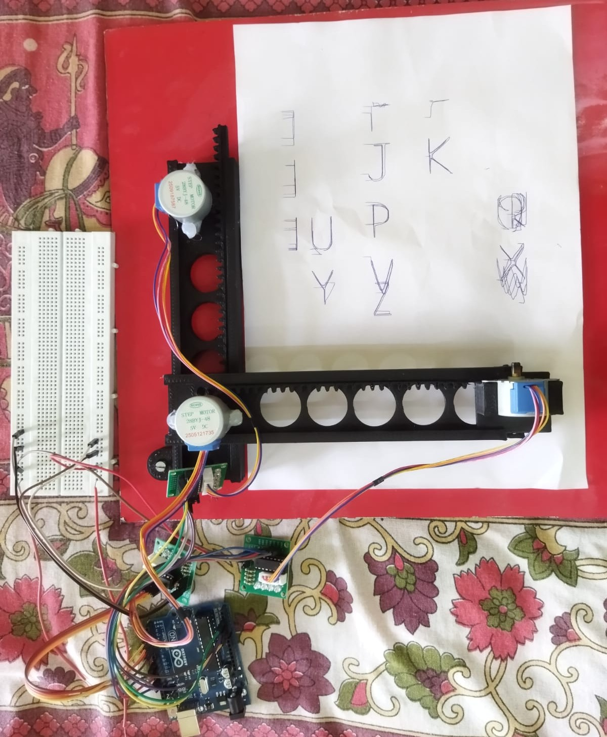
Hardware Setup
The system is built around an Arduino Uno, which acts as the main controller and executes the G-code instructions for the plotter.
ULN2003 stepper motor drivers are connected to the Arduino to control the X-axis and Y-axis stepper motors, ensuring precise positioning and smooth movement.
An 28BYJ-48 stepper motor is mounted on the pen holder to lift and lower the pen during the drawing process.
All components are interconnected using jumper wires and powered by an external 5V to 9V DC power supply, ensuring stable operation of the motors and controller.
After assembling the hardware, the plotter is tested and calibrated to achieve accurate and repeatable 2D plotting.
Notes:
Image source: https://www.slidemake.com

Slide 6
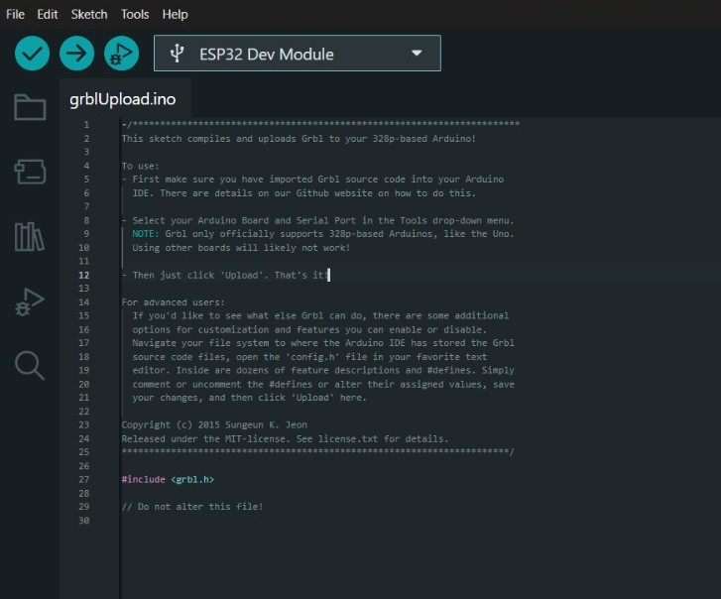
Software and Programming
The GRBL firmware is uploaded to the Arduino Uno using the Arduino IDE, enabling it to interpret G-code commands and control the stepper motors.
Inkscape is used to create or import images and convert them into vector image then we use Jscut for covert them into G-code, which contains the movement instructions for the CNC plotter.
The generated G-code is transmitted to the Arduino using Universal G-code Sender (UGS), which provides communication between the computer and the plotter.
The Arduino processes the G-code and controls the X-axis, Y-axis, and pen holders, allowing the pen to draw the desired pattern accurately.
The software workflow ensures precise motion control, smooth plotting, and repeatable drawing performance.
Notes:
Image source: https://hacksterio.s3.amazonaws.com

Slide 7
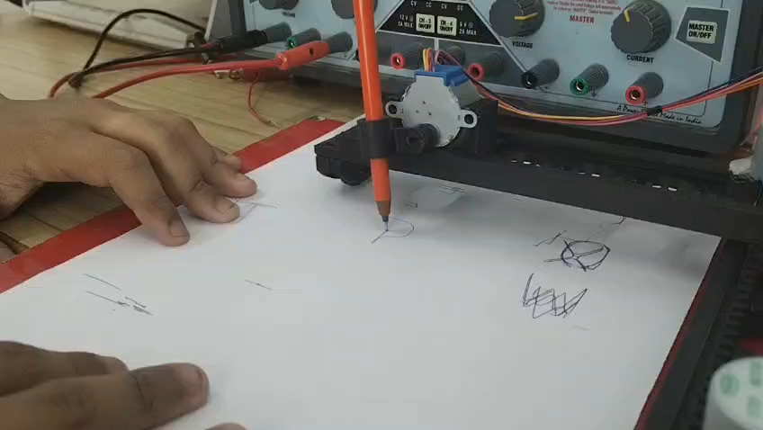
:Video Presentation of Arduino based Mini CNC Plotter:

Slide 8
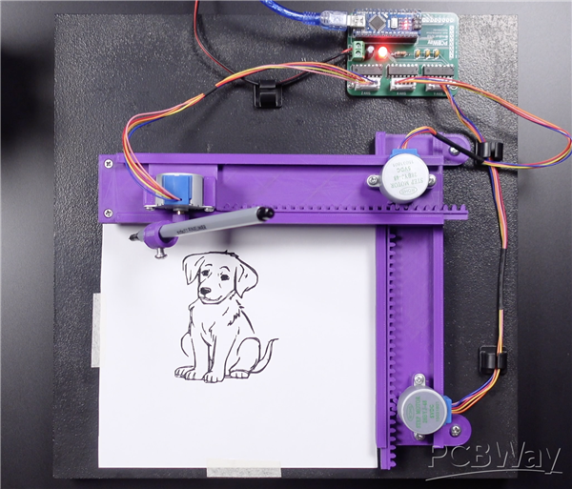
Applications and Uses:
Engineering Drawing: Used to draw precise diagrams, graphs, and geometric shapes for educational and technical purposes.
PCB Prototyping: Helps create simple Printed Circuit Board (PCB) layouts before the manufacturing process.
Educational Projects: Used in colleges and laboratories to demonstrate CNC technology, automation, robotics, and embedded systems.
Art and Design: Capable of creating logos, calligraphy, sketches, greeting cards, and decorative patterns with high accuracy.
Signature and Document Automation: Can automatically reproduce signatures, text, and repetitive drawings, reducing manual effort.
Research and DIY Projects: An affordable and customizable platform for students, hobbyists, and researchers to develop CNC-based applications.
Notes:
Image source: https://www.slidemake.com

Slide 9
Advantages and Limitations:
Advantages:
Low Cost: Built using affordable and easily available components such as Arduino Uno, stepper motors, and servo motors.
Easy to Customize: Open-source hardware and software allow users to modify and upgrade the system according to their requirements.
High Accuracy: Provides precise 2D drawing for educational projects, PCB layouts, and artwork.
Limitations:
Limited Working Area: Suitable only for small-scale drawings and prototypes.
Lower Speed: Operates slower than industrial CNC machines.
Limited Functionality: Primarily designed for 2D plotting; cannot cut or engrave hard materials without modifications.
Calibration Required: Proper alignment and periodic maintenance are necessary for accurate plotting.
Notes:
Image source: https://i.pinimg.com

Slide 10
Future Developments and Improvements:
Addition of a Z-Axis: Upgrade the plotter to a 3-axis CNC machine for engraving, cutting, and light machining applications.
Wireless Control: Integrate Bluetooth or Wi-Fi (ESP32/ESP8266) for remote monitoring and operation through a smartphone or computer.
Improved Precision: Use linear guide rails, better stepper motors, and high-quality timing belts to increase drawing accuracy and reduce vibration.
Laser Engraving Module: Replace the pen with a laser engraving module to engrave designs on wood, plastic, leather, and acrylic.
Automatic Pen Changer: Design a mechanism to switch between multiple colored pens automatically for multicolor drawings.
AI and Image Processing: Integrate Artificial Intelligence (AI) and image processing to automatically convert images into optimized G-code for faster and more accurate plotting.
Notes:
Image source: https://www.slidemake.com

Slide 11
References:
Arduino. Arduino Uno Rev3 Documentation. Available: https://docs.arduino.cc/hardware/uno-rev3/
Arduino IDE Documentation. Available: https://docs.arduino.cc/software/ide/
GRBL Project. GRBL: Open-Source CNC Firmware for Arduino. Available: https://github.com/gnea/grbl
Inkscape Project. Inkscape User Guide. Available: https://inkscape.org/learn/
Universal G-code Sender (UGS). Official Documentation. Available: https://winder.github.io/ugs_website/

Slide 12
Thank You

